Slide 1
Crime trends in select American cities
Impact of COVID 19 on Crime in America

Slide 2
Executive summary
Scope of the Study and Summary Findings

Slide 3
Our Study
Our team evalued crime trends across six major metropolitan areas in the United States for which relatively standardized crime reporting statistics were available. The team looked at the following US Cities:
Denver
Seattle
San Francisco
Los Angeles
Philadelphia
Washington DC
For each city, we looked at monthly crime statistics categorized by:
Violent vs. non-violent
Offense category
Our goal was to determine whether there was any correlation between the outbreak of COVID-19 and crime trends in those cities for which we were able to pull data
Our analysis includes the following:
Correlation of COVID-19 reported cases vs. crime trends overall and crime trends in each city
For each city, a review of:
Crimes by offense
Violent vs. Non-Violent Crimes
Monthly crime trends

Slide 4
Crime Reporting and Classification
While the data sets for each city were similar, the crime offense codes vary by city. Thus for our correlation of crime trends with COVID-19, we focused on correlation with violent and non-violent crimes
The team manually coded violent and non-violent crime offenses based on the following general guidelines:
Non-Violent Crimes – Most often classified as “Property Crimes”:
Theft, larceny embezzlement, receipt of stolen goods, and arson
Contract crimes, fraud, tax crimes, and other forms of white collar crimes
Drug and alcohol-related crimes
Prostitution
Racketeering and gambling
Bribery
Traffic offenses
Violent Crimes – Most often classified as “offenses against the Person”:
Assault and battery
Homicides
Domestic violence
Robbery
Sexual assault and abuse
False imprisonment

Slide 5
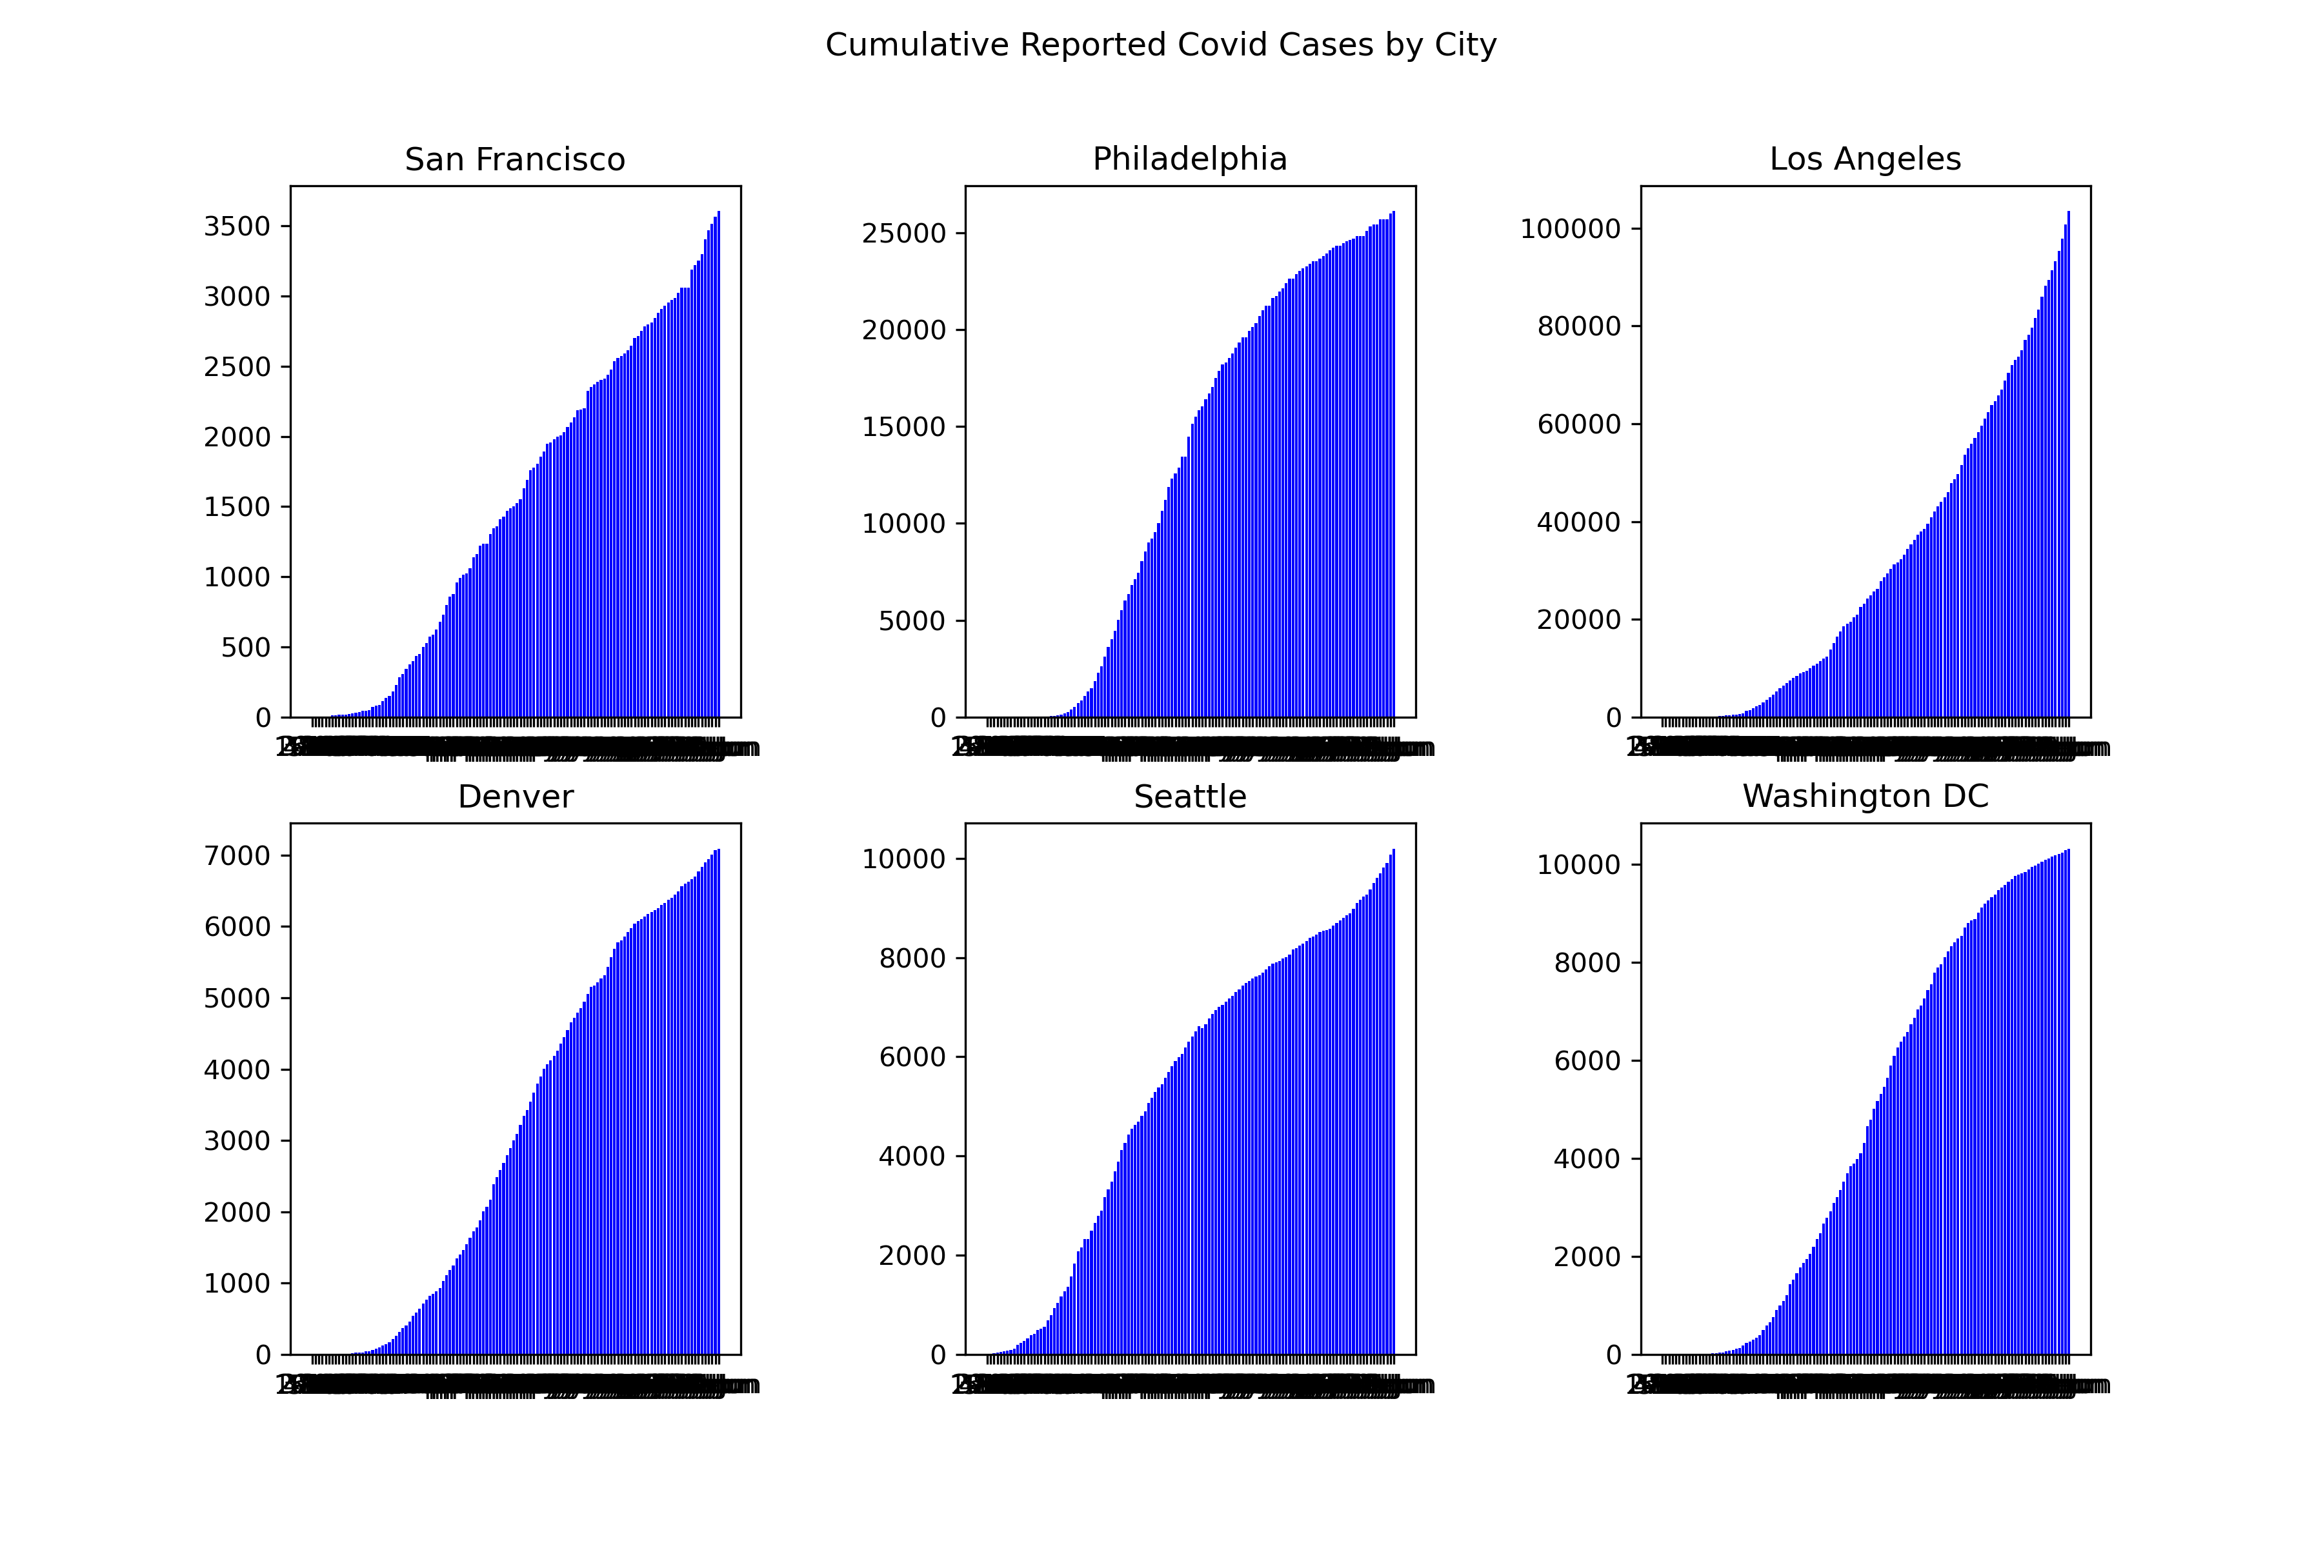
Reported Covid Cases in Selected Cities
Top Outbreaks:
Los Angeles
Seattle
Washington DC

Slide 6
Crime Count in Selected Cities
Similar chart format as previous page

Slide 7
Crime Trends vs. COVID 19 Reported Cases
Insert scatter plot and regressions
Summary findings

Slide 8
Crime Trends vs. COVID 19 Reported Cases
Insert scatter plot and regressions
Summary findings

Slide 9
Appendix
City Data

Slide 10
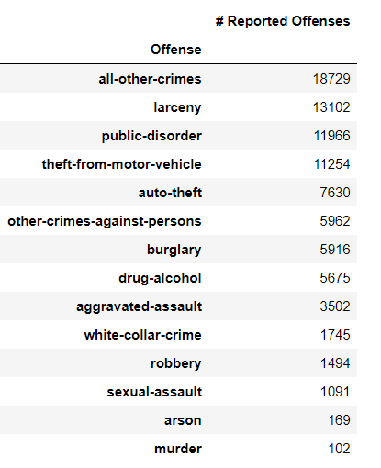
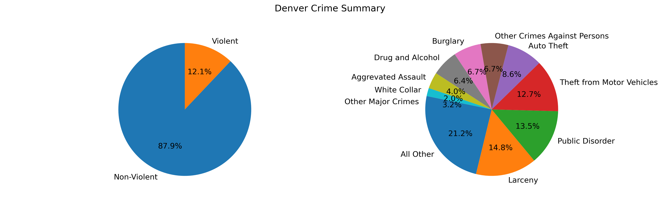
Denver – Overview of Crime by Offense
Source data and cleaning efforts
Source: www.denvergov.org
Data included traffic violations; our analysis adjusted the data to exclude traffic violations and focused on property crimes and criemes against the person
During the period of our analysis (Mar 1, 2019 through June 30, 2020), Denver experienced roughly 88,000 crimes, or 181 crimes per dayCommentary on Denver Crime Stats
Insert panda dataframe on summary stats

Slide 11
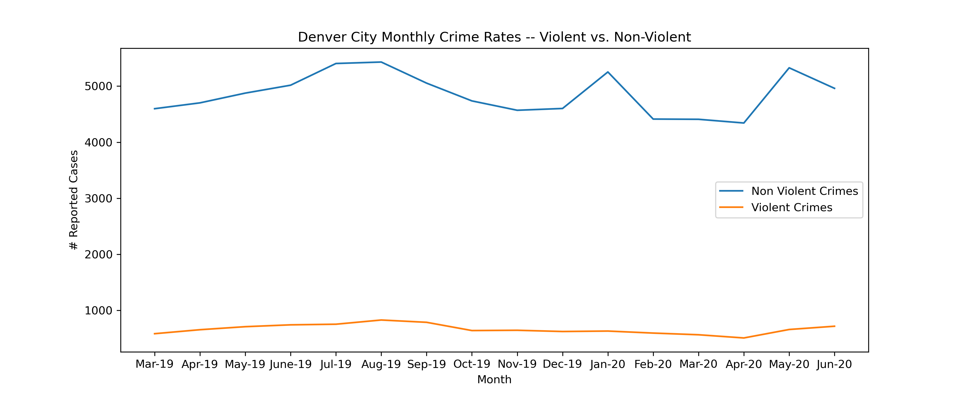
Denver Crime Trends – Violent vs. Non-Violent
Denver’s crime rates have been relatively flat over the last 16 months, although we would note a general decline in crime beginning in August 2019 before increasing in April of 2020
While this does not appear to be seasonal, we don’t have enough data to confirm this trends and would note that given Denver’s climate, more crimes may occur in the spring and summer seasons when the weather is warmer and more people are active and outdoors
The team also notes the relatively high increase in non-violent crimes during May 2020, which was the highest monthly increase during the period studied

Slide 12
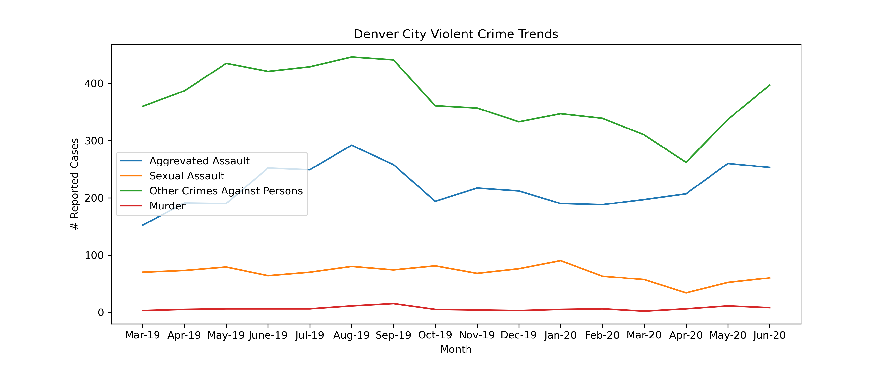
Denver Crime Trends – Violent Crimes by Offense Type
All Violent crime offense types – Aggrevated and Sexaul Assault, Other Crimes Against Persons, and Murder – experienced an uptick in reported cases in May 2020
However, overall Violent crime cases were in line with the same period last year

